Slide 1


Limitations of Cyber Investigations & Digital Forensics
Sagarika Chakraborty
Sagarika@iirisconsulting.com
www.iirisconsulting.com
© 2016
NATIONAL JUDICIAL ACADEMY, BHOPAL
MARCH 28, 2016

Slide 2

Table of Contents
The Fight
The Web of Cyber Crime
Effective Combats Against Cyber Crime
Limitations – Difference in Perspective
Geography Based Differences
Technological Expertise
Case Study – The Curious Case of Missing Data
Bandwidth Challenges
Resource Challenges
Handling Data
Handling Smartphones – Being Smart?
Evidence Management
Legal & Jurisdiction Challenges
India
Way Forward – Collaborative Approach
Embracing the “E”s

Slide 3

The Fight!!!

Slide 4

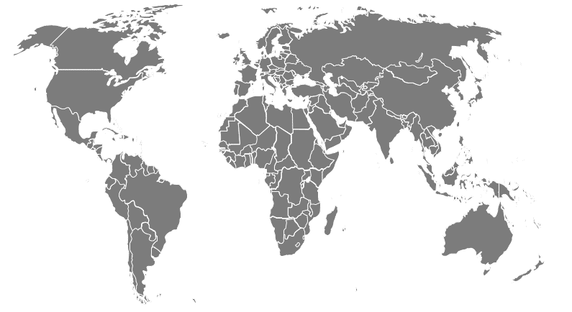
The Web of Cyber Crime
TERRORISM
STALKING
DATA THEFT
DEFAMATION / SEDITION
PIRACY
MONEY LAUNDERING
MURDER
SEX CRIMES
NO AREA REMAINS UNTOUCHED AND UNHARMED!!!

Slide 5
Effective Combats Against Cyber Crime
PREVENTIVE
REACTIVE
METHODOLOGIES
Monitoring using advanced algorithms / methodology
Forensics using advanced technological tools
Investigations supported by data analytics
EFFECTIVE COMBATS CONTAIN METHODOLOGIES THAT ARE A COMBINATION OF HUMAN INTELIGENCE, TECHNOLOGY BACKED ANALYTICS AND SWIFT IMPLEMENTATION OF ESTABLISHED LAWS.

Slide 6
Limitations – Difference in Perspective

Slide 7

Limitations – Geography Based Differences
DIFFERENCE IN TECHNOLOGICAL EXPERTISE
DIFFERENCE IN LEGAL POSITION
DIFFERENCE IN JUDICIARY POSITION

Slide 8
Limitations – Technological Expertise
Recovery / Retrieval from tampered discs (broken, burnt etc.)
DATA RECOVERY
EFFICIENCY
COUNTER MEASURE TACKLING
TIMELY ACTION
EXPERTISE
Recovery / Retrieval of deleted / corrupt data (Root File / Registry recovery etc.)
Time lapse in data recovery / retrieval and consequences (volatile RAM , external influences etc.)
Anti forensic software tools (creation of temporary virtual platform to work on and continuous erasure)

Slide 9
Case Study – The Curious Case of Missing Data
CASE BACKGROUND
INITIAL FINDING
Company suspected two of its senior employees to be involved in data pilferage and unethical gains. Therefore had referred the matter to IIRIS to conduct digital forensics.
Initial forensics showed that for both the machines data was missing from the years 2012 – 2015 (the period under suspect). However, no data was attempted to be deleted by the users.

Slide 10
Case Study – The Curious Case of Missing Data
(CONTD)…
Detailed forensic study helped unearth the presence of two anti forensic software that helped the users work and transfer data without leaving a trace / creating a back up:
CCleaner
The named software is counted in the category of established anti forensic software that helps a user delete all recent activities performed on the system. The software helps delete history, cookies and various software related logs and also prevents creation of logs for files that are cleaned and overwritten.
True Crypt
The said software helps the user work on a mounted platform so that he may not leave any traces of the files / information downloaded or worked upon. The platform when unmounted either to delete such files / information or to have them transferred to an external storage device, helps prevent a back up being created in any file memory of the system and thereby making it nearly impossible to trace / recover such information/data.

Slide 11
Limitations – Bandwidth Challenges
LACK OF DIGITIZED RECORDS – either not updated or not implemented. Manual screening hampers forensics and does not provide accurate results.
LACK OF INTEGRATION ACROSS DEPARTMENTS, DOMAINS – thereby hampering cross functional forensics – duplication of effort, resources, cost and time (often with no desired results)
LACK OF STRICT NORMS on what to digitize, how to store, where to store and how long to store. No centralized storage, leaving each institution / team to decide on own metrics
LACK OF ALLOCATED STORAGE SPACE with recommended conditions (cool, dry, sterile etc.) – leading to easier corruption of data.
LACK OF MULTIPLE CENTRAL AGENCIES / testing labs to speed up data analytics (leading to case closure delay and often data corruption)

Slide 12
Limitations – Resource Challenges
Lack of focus to develop forensics as a field of skill and expertise – degrees, certificates, skill trainings.
Lack of awareness and trainings about modern techniques, advanced software and methodologies.
Lack of continuous review to understand system lags, plan for upgrades and also ensure compliance with monetary standards
Skill Induction
Training & Awareness
Review & Compliance
SECURITY & INFRASTRUCTURE FORMS A PART OF THE BUDGET CONSIDERATION EACH YEAR. HOWEVER NO FOCUS ON ALLOCATION OF FUNDS AT THE MICRO LEVEL TO ENHANCE REQUIRED INVESTIGATIVE SKILL SETS

Slide 13
Resource Challenges – Handling Data
“Computer forensics is the equivalent of surveying a crime scene or performing an autopsy on a victim” (James Borek, 2001)
Original Data Handling
Minimal handling of original data
Accounting for changes
Evidence Management
Handling Chain of Custody
Quality Control
Following Rules of Evidence
Handling of data only by qualified experts
Ensuring evidence integrity
CRITICAL PARAMETERS

Slide 14
Handling Smartphones – Being Smart?
MOBILE V. LAPTOP / COMPUTER
The key difference in a smart phone
Smartphones operate through inter working of operating system layers because layers depend on each other.
DATA TAMPERING
Innovative software & differential handling
A smartphone in order to hide data can have a self destruction mode inbuilt through the SIM card that is retained and therefore can corrupt all data inside (e.g., use of Wickr)
BEYOND ISPs
Use of remote devices for log in through Wi Fi and other sources
ISPs can only help trace when the route was used to send messages / data.
Applications written by third party developers can access specific OS layers and as a result tamper with the file system and erase digital evidence.
Other applications could deliberately delete important artefacts such as messages and logs to hide digital footprint of a crime taken place in a smartphone
A smart phone needs special handling by removal of SIM, battery etc, and analysis in a dedicated space.
In case the SIM was removed and the attacker used Wi Fi network (unsecured) or used a stolen phone where the earlier messaging platform was not deactivated, then it cannot be traced just through ISP. It needs dedicated testing devices like Oxygen Forensics and UFED Physical Analyser.

Slide 15
Handling Data – Evidence Management
COMMON CHECKLIST POINTERS THAT ARE MISSED
Can the information in the "chain of custody" form prove the "continuity of evidence"?
Is the information present in the "chain of custody" form known and acceptable by all parties present?
Can the process of evidence management help determine the following:
Being able to determine which evidence came from which piece of hardware,
Where that piece of hardware was retrieved from,
Documenting all persons handling the evidence,
Ensuring secure storage of the evidence with limited accessibility,
Documenting all processes used to extract the information,
Ensuring that those processes used are reproducible, and would produce the same result.
ALMOST 80% OF THE FORENSIC FINDINGS ARE CHALLENGED AND NOT SUSTAINED ON GROUNDS OF IMPROPER HANDLING OF EVIDENCE

Slide 16
Limitations – Legal & Jurisdiction Challenges
FACTORS THAT AFFECT THE PROCESS
CULTURAL SENSITIVITY
INCREASED CORPORATE PROTECTION
UNDERST-ANDING OF CRIME
Difference in laws on privacy, evidence etc.
Difference in perception & acceptability of breaches
Refusal by corporate to de-crypt / divulge details – Gmail, Apple, Yandex, Blackberry

Slide 17
Legal & Jurisdiction Challenges – India
To understand the position of digital / cyber forensics in India, a combined reading of the Indian Evidence Act, 1872 is required along with the Informational Technology Act, 2000 and Indian Penal Code, 1860.
However, despite the same there remains a few challenges that are unresolved and delay and hamper the smooth functioning of the judiciary while dealing with such cases.
LACK OF EXPERTS
Lack of specialized Courts
Lack of specialized / trained judges / lawyers (no requirement)
JURISDCITION ISSUES
Unresolved issues with many international counterparts
Confusion of applicability of foreign judgements / Indian judgements on foreign shores
ADMISSIBILITY OF EVIDENCE
Specifications not backed by technological solutions
Equal status to secondary evidence / third party assessments with increasing importance

Slide 18
Way Forward – Collaborative Approach

Slide 19
Way Forward – Embracing the “E”s
EMPOWER
Courts, law enforcements, third party experts
EDUCATE
Awareness for skill development, specialized training for enforcement agencies
ENGINEER
Innovative solutions for technological combats
ENGAGE
Conversation with foreign jurisdictions

Slide 20

THANK YOU
www.iirisconsulting.com

